Slide 1
12515 - Little Brick's Dream

Slide 2
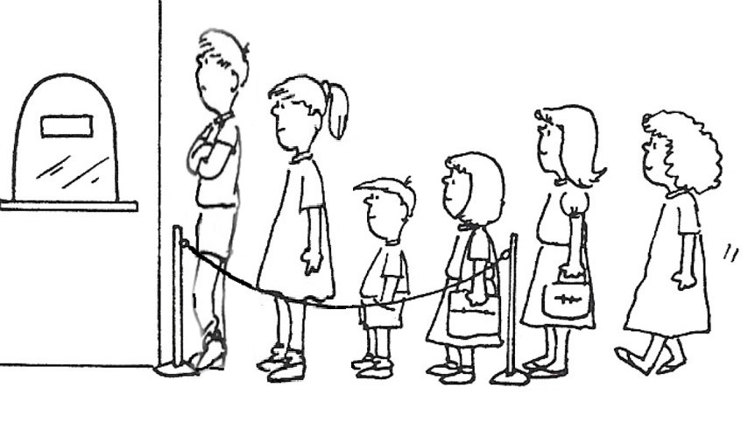
Problem
Little Brick told you that he is waiting in a long line.
Can you find Little Brick’s position based on his comfort level?

Slide 3

Input
Comfort level f(i) of person i:
the number of consecutive people standing in front of him, and are shorter than him.
The first line contains 2 integers N, X, - N is the number of people,
- X is the comfort level.
The second line contains N integers Ai, separated by spaces, where Ai represents the height of the person standing at the i_{th} position. 1 <= N,X <= 10^7
1 <= Ai <= 10^9
f(9)=
3
3
2
1
1 2 3 4 5 6 7 8 9

Slide 4
Output
Print all possible positions where Little Brick may be at, separated by blanks. If there is no possible position, output “ouo”.
The indexes of positions start from 1, and you must output the indexes in increasing order.

Slide 5
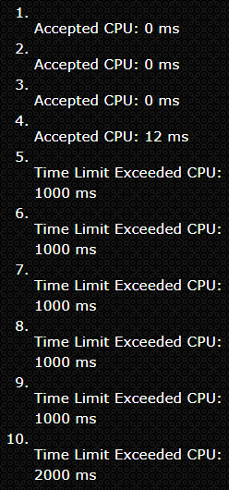

Idea - Brute force
If we compare all the people before little brick until someone taller than him.
Time complecity: O(n^2)
0
0
1
1
End
End
0
End
End
1 2 3 4 5 6

Slide 6
Idea - Enhanced
Use an array confort_level[ ] to save the confort levels.
Consider f(5):
heights[5] > heights[4]
since f(4) = 1, jump to 4 - f(4) – 1 = 2
1
1 2 3 4 5 6

Slide 7
Idea - Enhanced
Use an array confort_level[ ] to save the confort levels.
Consider f(5):
heights[5] > heights[4]
since f(4) = 1, jump to 4 - f(4) – 1 = 2
2. heights[5] < heights[2], we can compute f(5) = 5 – 2 – 1 = 2.
1
End
Based on the f(4) = 1,
we can skip this step
1 2 3 4 5 6

Slide 8
Code
for( i=1; i<=n; i++) {
scanf("%d", &heights[i]);
for( j=i-1; j>=1; ) {
if(heights[j] < heights[i])
else break;
}
confort_level[i] = i-j-1;
if(confort_level[i] == target) ans[cnt++] = i;
}
j -= confort_level[j]+1;
1 2 3 4 5 6

